Slide 1
Go over thesis and make sure you included all the stuff written there in each section here
Add refrences

Slide 2


Show some sensitivity!
Using motion tracking to explore unconscious measures
Khen Heller
Under the supervision of Liad Mudrik

Slide 3


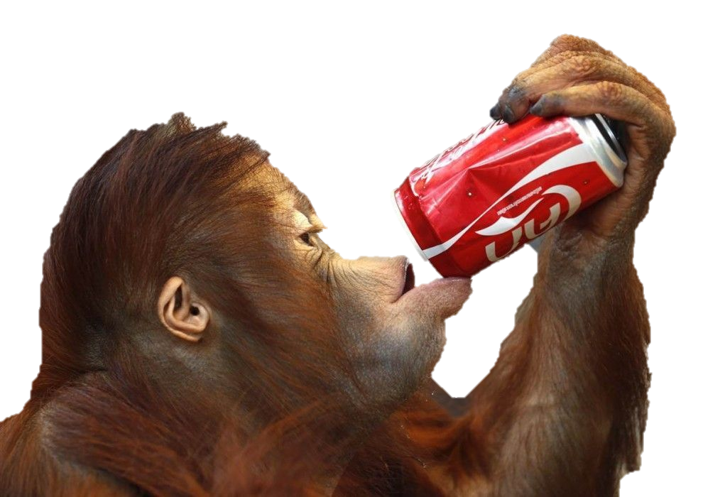

Un
conscious processing
Stimuli
Processing
Perceived
Affects Behavior
Notes:
In day to day we our brain receives a lot of information
He than processes it.
Some of is consciously perceived, and thus called conscious
And as a result affects our behavior.
But we don’t perceive everything we processes,
Some of the information doesn’t enter our awareness,
But can still affect our behavior (references)
This type of processing is called unconscious

Slide 4



Un
conscious processing
Stimuli
Processing
Perceived
Affects Behavior
Degrading physical properties
Suppression with salient stimuli
Diverting attention
Notes:
When one wants to research this type of information he can use 3 methods to render it UC:
degrading its physical properties (contrast, duration, intensity, size),
suppressing ti with more salient stimuli,
diverting attention.
All of which decreases visibility, but also decrease the neural response, → weaker behavioral change
How would one go about measuring the unconscious effect you ask? Well…

Slide 5
Measuring the Unconscious effect
Priming paradigm
Congruent
RADIO
RADIO
RT
radio
Time
radio
Subjective Objective
Natural / Artificial
How well did you see the first stimuli?
On a scale of 1-4
CLOUD / RIVER
1 2 3 4
Notes:
The most prominent method is the priming paradigm with a Keyboard RT measure.
A prime precedes the target, is rendered invisible, e.g. by masking with salient stimuli
Participant perform a task on the target, e.g. classify as artificial / natural.
To verify that prime is indeed invisible, two types of measures are available:
Subjective – participant asked about his experience of the prime.
Objective – participant is asked to perform a judgment about the prime, and the invisibility is inferred from low accuracy..
Prime,target can be either
congruent – evoke the same response, facilitation

Slide 6
Measuring the Unconscious effect
Priming paradigm
Incongruent
Congruent
CLOUD
RT
Time
radio
Natural / Artificial
Notes:
Or incongruent – evoke opposite responses, restriction

Slide 7
Measuring the Unconscious effect
Priming paradigm
Incongruent
Congruent
Congruency effect
CLOUD
RT
Time
radio
Natural / Artificial
Greenwald et al. (1996); Van den Bussche et al. (2009)
Notes:
To Measure the effect we compare the RT between the conditions and that difference gives us the congruency effect.
It implies that the prime was unconsciously processed.
Problem is this effect is usually very small when recorded with a keyboard (add references)

Slide 8




Consequences of Low Sensitivity
Problem: Common measure can’t pick up the effect
Consequence: controversy
Explanation: Underestimation of the effect
Solution: Increase sensitivity
Contradicting findings:
Hesselmann & Knops (2014)
Kouider et al. (2009)
Moors et al. (2016)
Mudrik & Biderman (2017)
Peters & Lau (2015)
Notes:
The problem with a small effect is that it is hard to detect,
Which leads to contradicting findings (references)
that in turn evoke controversy on the scope of UC processing. (references)
Some say:
Unconscious processing can perform high level functions and have a small but existing affect on behavior, (references)
Others say:
It is negligible, and the parts of it that can be found can be explained by conscious influence. (references)
One explanation that can account for the contradicting findings is methodological limitations that cause an underestimation of the UC effect
solution - more sensitive measure
Controversy:
(Desender & Van Den Bussche, 2012; Hesselmann & Moors, 2015; Michel, 2019; Peters et al., 2017; Peters & Lau, 2015)

Slide 9
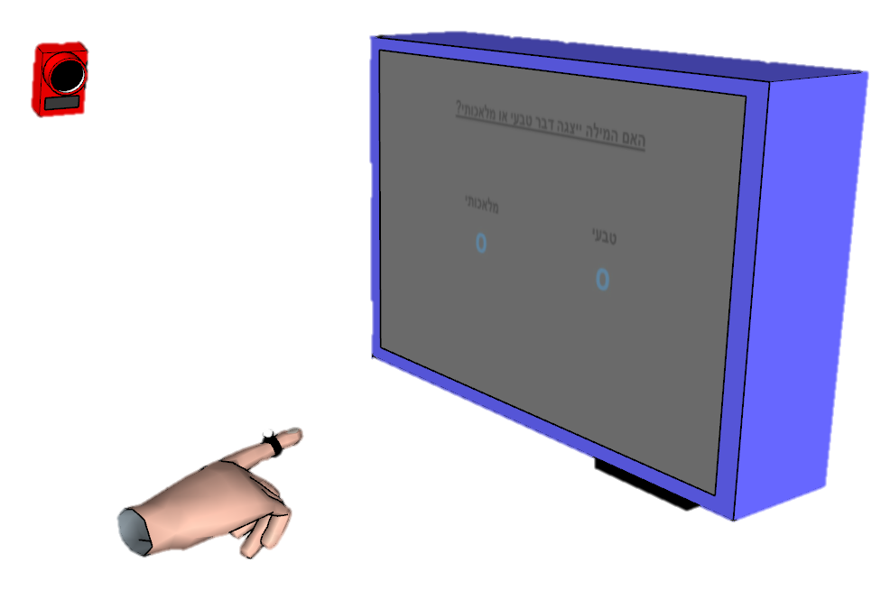
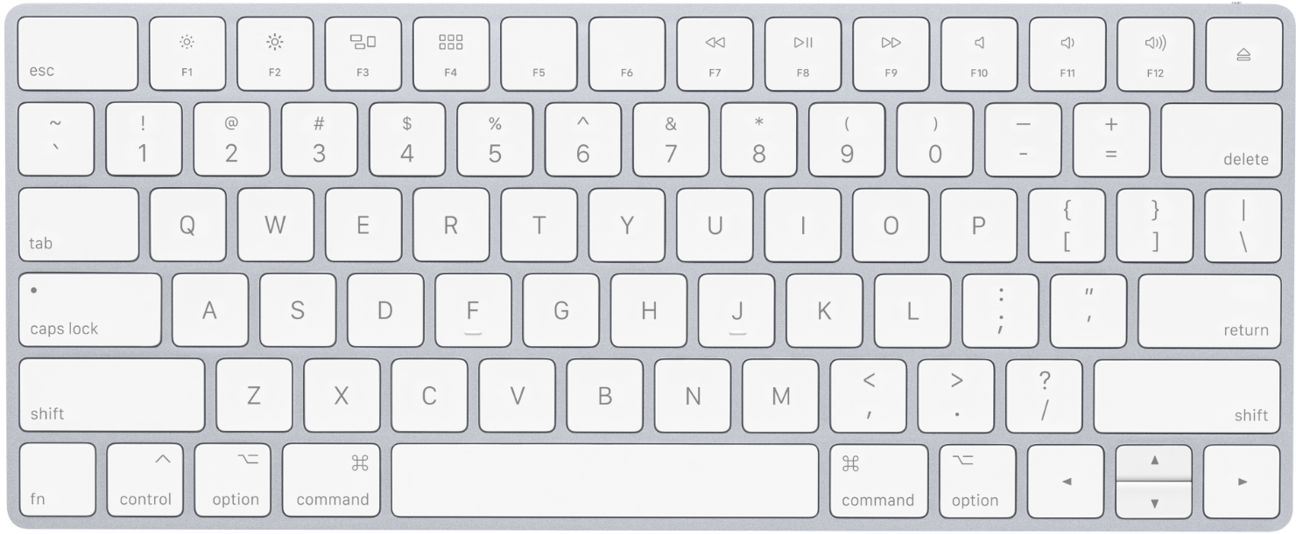
Improving Sensitivity
Single value
Post decision
“Poor” – RT, accuracy
Continuous
Online
“Rich” – RT, onset, MAD, velocity…
Notes:
One option for improving sensitivity is to use motion tracking,
Which has become a popular tool for probing unconscious effects. (references)
This tool has three main advantages over the usual keyboard response measure:
(references)
Continuous – more suitable for ongoing cognitive processes
Rich – allows to capture effect which aren’t detectable in other parameters of the response.
Question is, is motion tracking more sensitive than keyboard RT?

Slide 10
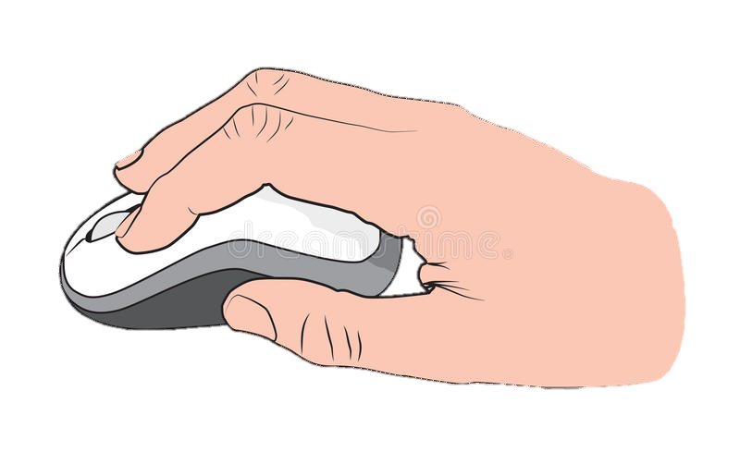
Xiao et al (2015)
VS
Cohen’s d = 0.65
p = 0.06
Cohen’s d = 1.97
p < 0.001
Time
3 \ 3
Same / Different
Notes:
To date,
Only one study directly compared them (reference)
Importantly, it found a robust weffect when using mouse tracking,
While the keyboard effect was only marginally significant.

Slide 11
Xiao et al (2015), Limitations
Limited awareness measure:
Low number of awareness trials
Awareness on separate block
Correlation underestimates awareness
Malejka et al. (2021)
d’ > 0
Mouse tracking Vs Reaching:
Constrains movements
Lower velocity
Longer movement duration
Smaller curvatures
Slower responses to COM
Desmurget et al. (1997)
Palluel-Germain et al. (2004)
Moher & Song (2019)
Less intuitive less fluctuations in decision
Burk et al. (2014); Moher & Song (2014)
Mouse
4000
Congruency effect (AUC)
2000
0
Keyboard
400
200
Congruency effect (RT)
0
-200
0.0
0.4
0.8
d’
Notes:
Limitations:
Awareness:
96 trials isn’t enough to detect awarenesss according to work in our lab.
Estimating awareness in a separate block doesn’t allow to draw conclusions about awareness in single trial level.
To estimate awareness they estimated the correlation between the awareness score (d’) and the performance score (AUC/RT).
Since no correlation was found and the intercept at zero awareness shows a congruency effect larger than 0, they conclude UC processing occurred.
This analysis has been highly criticized since the correlation is limited by the reliability of each measure.
Therefor it understimates awareness.
d’ (sensitivity to prime) seems to be larger than 0.
Tracking:
Constrains movements - Mouse require remapping to 2D space, which might constrain movement, and thus affect the rrajectory and timing and prevent the effect from being expressed.
Less intuitive – therefor more effortfull and thus might be less likely to express fluctuations in decision (reference) which are important to us when looking for a congruency effect.

Slide 12
Xiao et al (2015) Current Study
Limited awareness measure:
Low number of awareness trials
Awareness on separate block
Correlation underestimates awareness
Malejka et al. (2021)
d’ > 0
Mouse tracking Vs Reaching:
Constrains movements
Lower velocity
Longer movement duration
Smaller curvatures
Slower responses to COM
Desmurget et al. (1997)
Palluel-Germain et al. (2004)
Moher & Song (2019)
Less intuitive less fluctuations in decision
Burk et al. (2014); Moher & Song (2014)
Rigorous awareness measures:
240 trials, for each measure
Estimate at single trial level
Subjective + Objective
Reaching movements:
Free movement
Intuitive
Notes:
To address all these issues,
In the current study I used a rigorous awareness measuring procedure.
240 awareness trails
Estimated at a single trials level,
And used both subjective and objective measures,
To make sure I can locate any residual awareness.
Additionally,
Reaching movements
Do constrain movement,
Is more intuitive

Slide 13
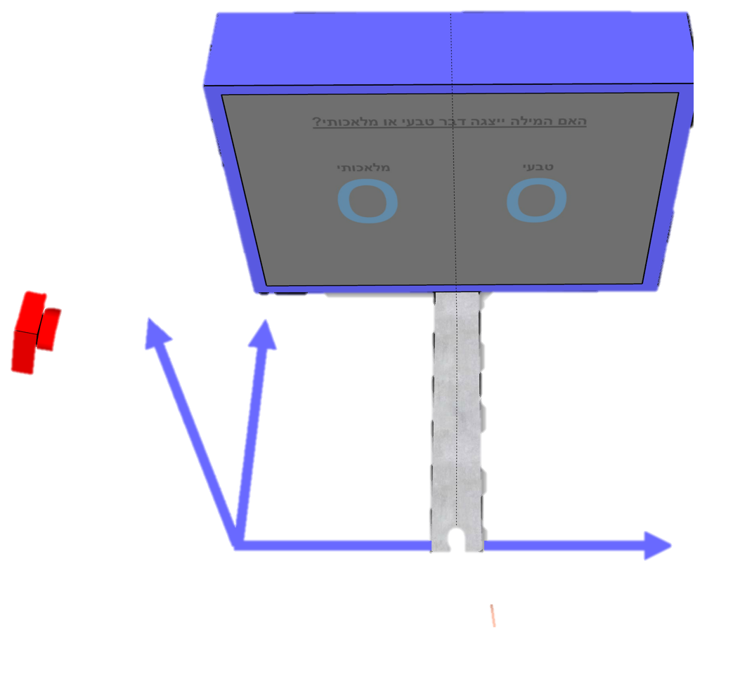
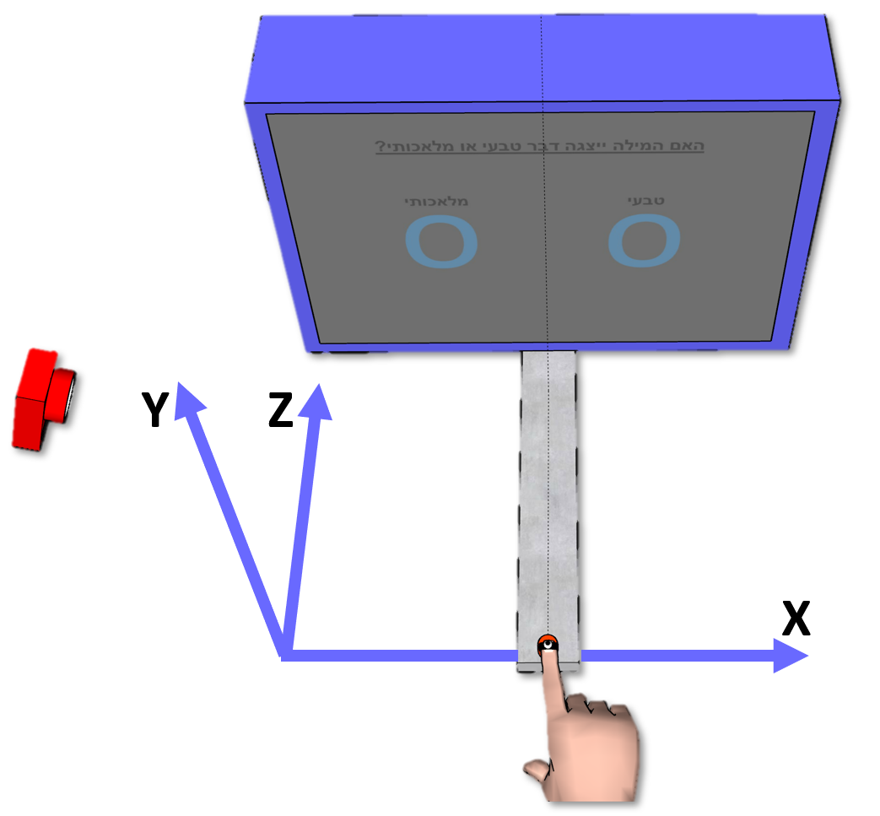
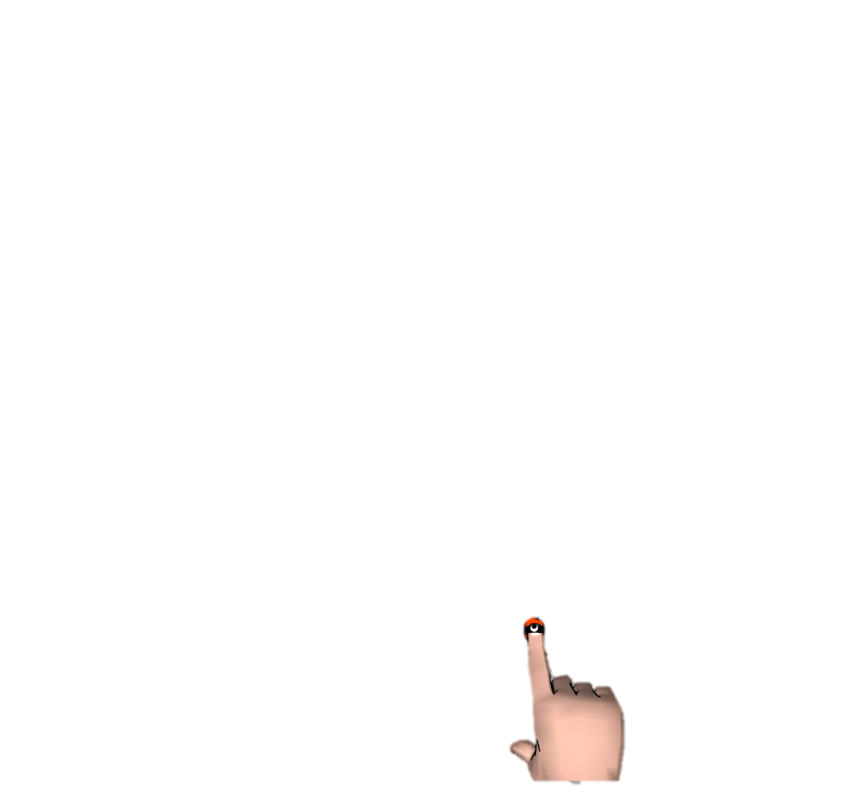
Current Study - Paradigm
Congruent - Same word
Incongruent - Different word
Different category
Congruency effect = Con - Incon
1000ms
270ms
30ms
Artificial Natural
RADIO
TREES
radio
30ms
Time
30ms
Artificial Natural
radio
0-1500ms
RADIO PHONE
How well did you see the first stimuli?
On a scale of 1-4
1 2 3 4
Notes:
The paradigm was a priming paradigm
Prime and target words are displayed
Participant asked to classify the target.
FC – afterwords he is asked to identify the priem between two options
PAS – rate visisbility
To capture responses we used motion tracking,
To select answer participant reach it.
Congruenct condition
Incongruenct condition,
Congruency effect reflected by diff between trajectories

Slide 14

Current Study - Measuring the effect
Reaction time
Movement duration
Reach area
Traveled distance
Changes of Mind
Screen
Screen
Screen
Reach Area
% Path Traveled
% Path Traveled
% Path Traveled
X
X
X
Notes:
COM – movement direction,

Slide 15
Current study
Pilot Experiment 1
Reaching
Pilot Experiment 2
Reaching
Exploratory
Confirmatory
Pilot Experiment 3
Reaching
Experiment 4
Reaching + Keyboard
Notes:
Three studies aimed at finding the optimal conditions for detecting an UC effect with motion tracking.
Fourth confirmatory study, that compares between motion tracking and keyboard response.

Slide 16
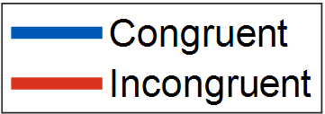
Pilot Experiment 1
Practice
1 block, with prime
Test
12 blocks, with prime
Long response time
Decision made before movement
N = 10
Notes:
First study included 10 participants.
Explain about Graph.
No difference was observed between the con incon trajs
Trend in reach area
Explain about graph
The reason: Long RT.

Slide 17
Evidence Accumulation
Artificial Natural
TREES
radio
Time
Notes:
To illustrate why long RT might be a problem, I will use an evidence accumulation model

Slide 18
Evidence Accumulation
Artificial Natural
Long response time
TREES
radio
Artificial
Evidence
Natural
Time
Notes:
The way evidence accumulation works,
Once stimulus is displayed, evidence accumulates in favor of the response that matches that stimulus.
Once it reaches threshold
Decision is made

Slide 19
Evidence Accumulation
Artificial Natural
Long response time
TREES
radio
Artificial
Evidence
Natural
Time
RT Limit
1500ms

Slide 20
Evidence Accumulation
Artificial Natural
Long response time
TREES
radio
Reaching
Artificial
Evidence
Natural
Time
Decision
RT Limit
1500ms
Notes:
If the sub reaches decision before movement,
The evidence accumulated in favor of the prime won’t affect the movement.
What about Cressman et al., 2007? Subs correct pre-planned movemnt after initiating it.
Yes, but the conflicting information is given during the movement,
While here it is given before the movement.

Slide 21
Evidence Accumulation
Artificial Natural
Long response time
TREES
radio
Reaching
Artificial
Evidence
Natural
Time
Decision
RT Limit
750ms
Notes:
Participnat will intiate movement earlier,
Since in this point in time evidence is in favor of the prime,
We might see its effect on the movement.

Slide 22
Pilot Experiment 2
Shorter RT Limit –
Reation time < 330ms
Movement duration < 430ms
Added practice to improve RT
Practice
1 block, w/o prime
Practice
1 block, with prime
Test
12 blocks, with prime
N = 9
Notes:
Shortenend RT
Added practice
Ran on 9 participants
Although results were not significant
We did observe some trends in the data

Slide 23
Pilot Experiment 2
Deviant participant
Many excluded trials (44.5%) low SNR
N = 9
Notes:
Two explanations why no significance:
Deviante participant – w/o results are significant
Many excluded trials – Demandin faster responses resulted in more trials excluded due to bad timing.

Slide 24
Pilot Experiment 2, w/o deviant

Slide 25
Pilot Experiment 3
Practice day – improve RT
Practice
6 blocks, w/o prime
Day 1
Day 2
Practice
1 block, w/o prime
Practice
1 block, with prime
Test
12 blocks, with prime
N = 7
Notes:
Added practice day
Results yielded a prominent difference between the trajectoriesin,
As expressed in smaller reach area in incongruenct condition,
Mean movement in incongruent is biased to incorrect answer
But none survived multiple comparisons correction.

Slide 26
Pilot Experiment 3
Marginal reduction in RT Less valid trials than Experiment 2
N = 7
Notes:
Suprisingly, the reduction in RT was only mariginal,
Moreover, the number of excluded trials seems to increase.
What cacn explain this? They might ask

Slide 27
Experiment 4
Keyboard session, Reaching session
Practice
1 block, with prime
Keyboard
6 blocks, with prime
Practice
1 block, with prime
Reaching
6 blocks, with prime
N = 30
Notes:
Pre-reg
30 participants
2 Separate sessions, one for keyboard, one for reaching,
Order counterbalanced.
Each session included 240 trials,
Estimated to give an effect according to the results of exp 3.
A bias towards the incorrect answer was found in incongruent trials.
Grey – Permutation& clustering ana;ysis foun these differences significant.
evident thorught almost entire trajectory (24-94%, 175-390ms)
The congruency effect was also expressed in the extracted variables.

Slide 28
Experiment 4
Cohen’s d = 0.69 Cohen’s d = 1.17 Cohen’s d = 1.17
N = 30
Notes:
Since incongruent trilas were biased towards the incorrect answer,
smaller reach area in incong,
And the movements were longer and took longer to complete.
The effect was also found in the keyboard task,
Longer RT in incongruent trials,
Since I used strict awareness measures,
And no residual awareness was detected,
The results provide strong evidence for the UC repetition processing,
Make one for step for settling the debate regarding its existence.
Results Pose
The effect in movement duration was comparable to the keyboard task.
However, the reach area effect was smaller.

Slide 29
Discrepancy with Xiao et al. (2015)
Xiao et al. (2015) Current study
Mouse
AUC
Conscious
Mouse is more sensitive?
Information lost in averaging?
Conscious > Unconscious
Accidental
Dynamic start - Scherbaum & Kieslich (2018)
Reaching
Reach area
Unconscious
Desmurget et al. (1997)
Palluel-Germain et al. (2004)
Moher & Song (2019)
Cohen’s d_{AUC} = 0.71
Cohen’s d_{reach area} = 0.69
Notes:
How can we explain the discrepancy?
Mouse is more sensitive to UC effect,
Unlikely considering prev findings (references):
Reachign more intuitive,
Places less constrains on movement,
Responds faster + greater curvature to COM
AUC estimated for each trial,
Reach area estimated with the average trajectories.
Information is lost when averaging.
However, post hoc showed AUC effect = reach area effect.
Xiao’s masking manipulaton wasn’t successful as his awareness measures indicate,
Meaning some of the stimuli was processed consciously.
Possibly, conscious processing leads to larger behavioral changes than UC.
One of the results are erroneous.
Further studies required to determine that.
Should use dynamic string condition since:
Increases movement consistency,
Increases curvature,
Decreases noise (reference).
Additionally, will prevent Too late, too early trials. -> increase SNR

Slide 30
Explaining the Results
Reaching is Noisy
More complexity Higher variability
Less valid trials Lower SNR
SD_{reach area} = 1.45
SD_{keyboard-RT} = 0.85
Long-lasting reach vs. short-lasting unconscious effects
UC effect in 24-94% of movement
Obscure the UC effect
Notes:
Reaching requires planning a trajectory to the screen,
Thus is more complex than simple key press.
More complexity means more place for variance
This might obscure the UC effect and make it harder to detect.
Notion is supported by STDs.
UC effects are short lived, while reaching is a long ongoing procedure.
Unlikely, considering their expression is visible thorught the movement (although it could have been expressed in the beginning and this is only an after effect of the hand already being displaced),

Slide 31
To Conclude
Robust evidence for unconscious processing
Motion tracking sensitivity is comparable to keyboard sensitivity
Less incorrect answers
Allows COM
Motion tracking tracks ongoing decision process
Motion tracking provides rich data
Incorrect answers
Notes:
Less incorrect – Participants can change their mind. Can reflect UC effect of prime.
Online information – opens the door for further investigations about the temporal dynamic of UC processing.
Rich data – allows to examine aspects of cognitive processes, unavailable when using keyboard.

Slide 32
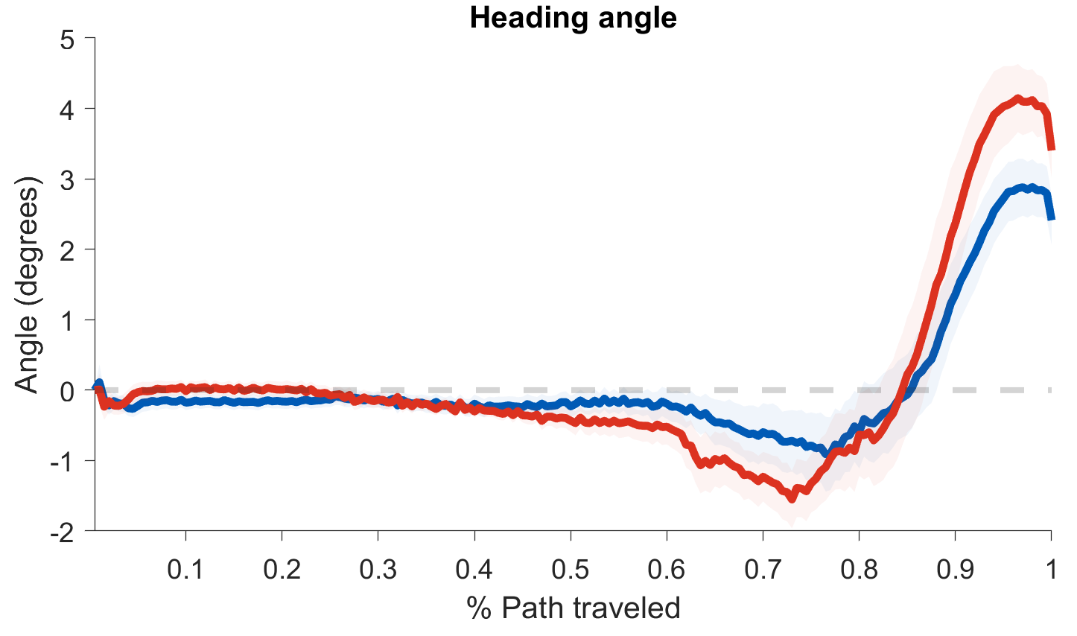
Open Questions
Heading angle
Trajectory SD

Slide 33
Jason might ask about changing the onset of subject movement to better delineate the timecourse of the UC effect.

Slide 34
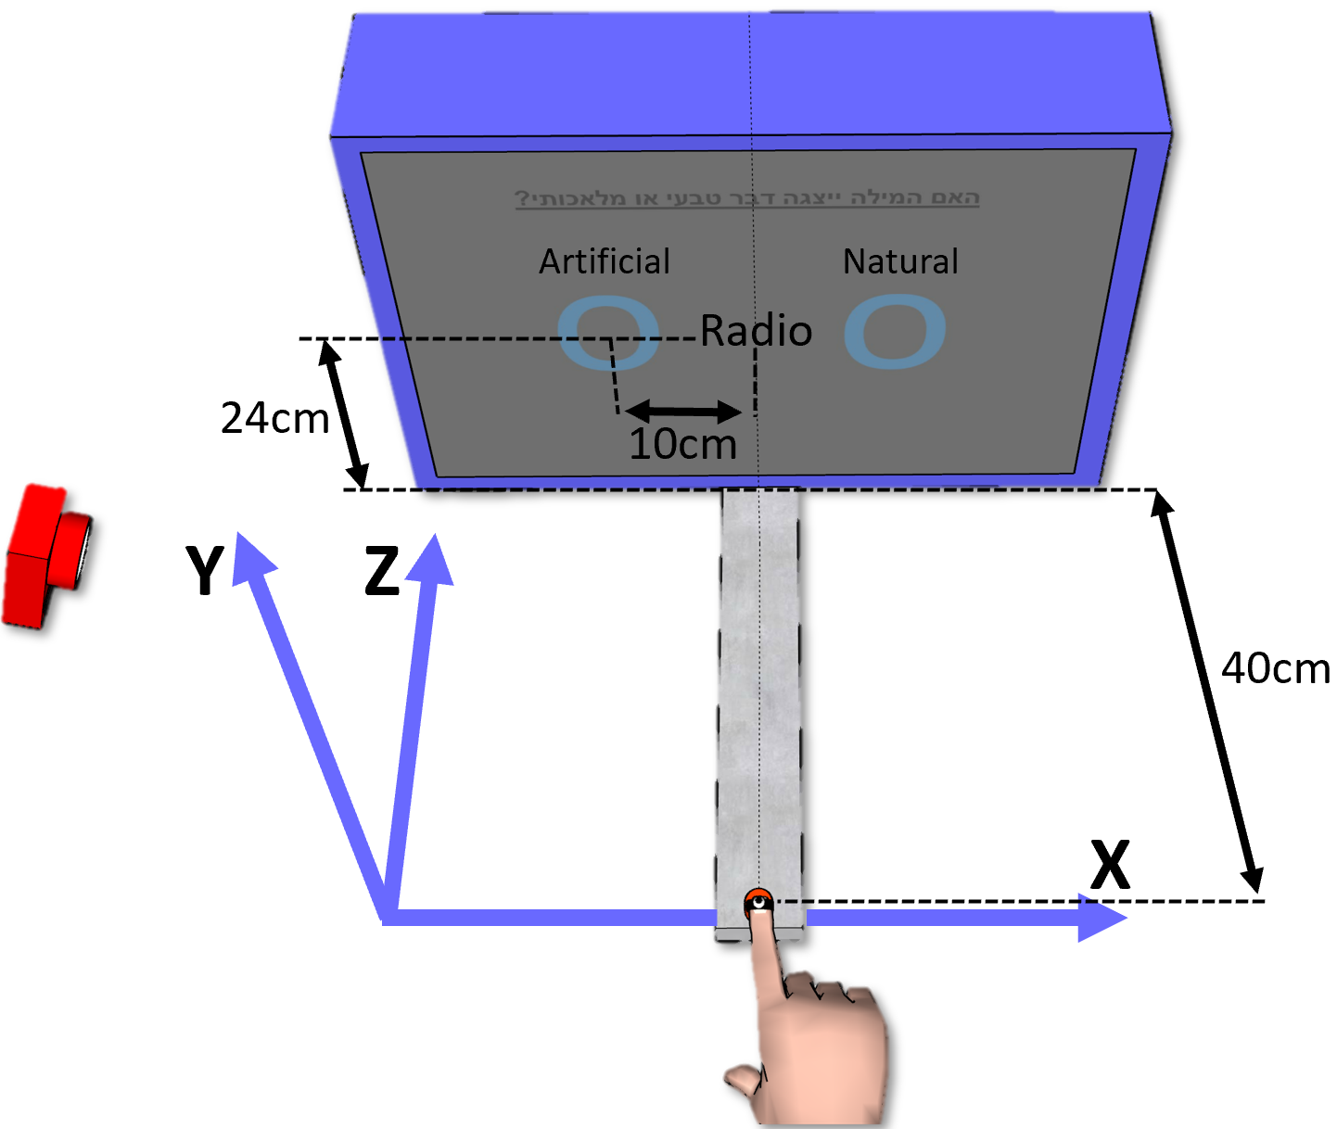
Setup

Slide 35
Preprocessing
XXXXXXX

Slide 36
Preprocessing
Exp 1
Exp 2
Exp 3
Exp 4

Slide 37
Feedback & RT Limit
Exp 1
Exp 2
Exp 3
Exp 4
Remember which feed back was given to which exp
RT limit of each exp

Slide 38
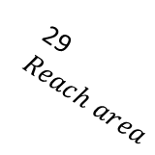
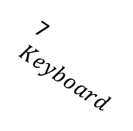
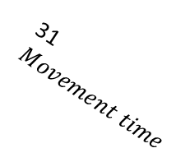
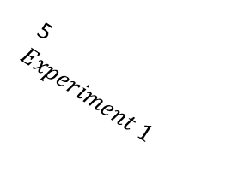
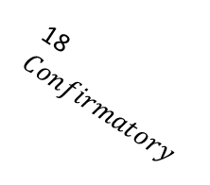
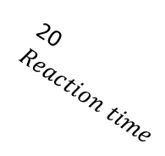


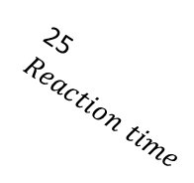
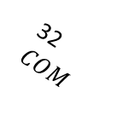
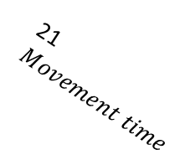
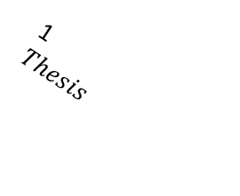
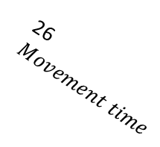
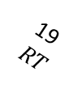

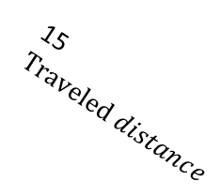
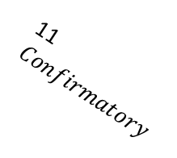
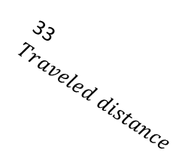

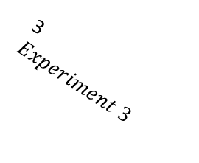

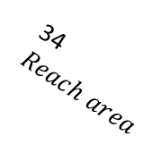
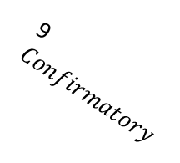
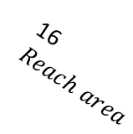
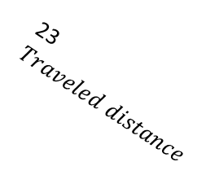
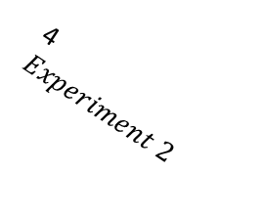
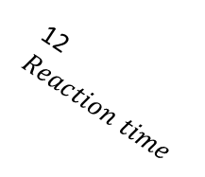
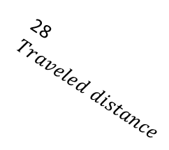

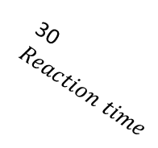
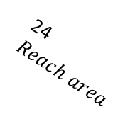
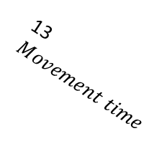
1
$Thesis$
2
Experiment 4
3
$Experiment 3$
4
$Experiment 2$
5
$Experiment 1$
6
Reach
7$Keyboard$
8$Exploratory$
14$COM$
15$Traveled distance$
16$Reach area$
9
$Confirmatory$
10$Exploratory$
11$Confirmatory$
12$Reaction time$
13$Movement time$
19$RT$
20$Reaction time$
21$Movement time$
22$COM$
23$Traveled distance$
24$Reach area$
25$Reaction time$
17$Exploratory$
18$Confirmatory$
26$Movement time$
27$COM$
28$Traveled distance$
29$Reach area$
30$Reaction time$
31$Movement time$
32$COM$
33$Traveled distance$
34$Reach area$

